Slide 1


Automotive engineering Teaching tool with interactive assistive elements
WSS551 Interactive Design for Web Systems - Fall 2022
Marios Pafitis
Vasileios Samaras

Slide 2
The idea
“ Learn Automotive Engineering TheMech way!’’
What if we could have a concise interactive tool to simplify the learning process of a complex mechanism?
When comes to automotive engineering learning process, students always encounter problems because of lack of visualization skills.
Conceptual thinking is the key to become an engineer and can dramatically improved with our web application!
An assistive presentation of a system’s assembly with the help of AR or MR, can help the teacher to show both units and parts of a system together with the system assembly with added layers of information. Thus, students shall be able to realize the system straightforwardly and avoid misconceptions, along with teacher’s guidance or in a self-paced manner anytime anywhere!
Now, students with different background and skills level, can exercise and realize the systems presented with quiz pages that provide information with a depth relevant to their academic level.

Slide 3
Why?
“ Learn Automotive Engineering TheMech way!’’
Affordable and easy way to access selective educational content.
[ Similar learning platforms are complicate for both students and teachers, and the walk-through process becomes counterproductive. The material is not combined to promote the mechanical system, and even expensive teaching material and extensive information lefts unexploited ]
Realize the system straightforwardly and avoid misconceptions with assistive interactive content.
[ Common learning platforms structure, is limited to ordered static content with photos, videos and information that usually teenagers do not have the patience to go through and read comprehensively. Interactive points of interest (Contextual enhancements by hovering) and information layers over 3d elements are changing the game of learning and realization]
Make the most out of productivity.
[ ∙ Teachers can enhance their lesson with interactive content, ∙ Students can exercise and realize the system presented together with a quiz, ∙ Both can attain straightforward valuable feedback metrics ]

Slide 4
The TheMech learning systems technology
An easier and smarter way to create customized web applications appending layers of 2D, 3D and pseudo-3D images over a basic background layer is introduced.
Our aim is to use as little hardware resources (internet bandwidth, GPU utilization, CPU utilization) as possible while maintaining the learning levels high.
Since, our web application will be used by mostly students, and usually students use their smartphones for accessing the internet, a lightweight system designed to be responsive and enjoyable.
[ At the current stage we use 2D images for illustrating the different systems, and in the future, we will test 3D images, videos or AR and VR ]

Slide 5
Project details [Part #1]
The methodology used to discuss and collect data from potential users.
The typical users of the system consist of two main categories:
(i) Educators and (ii) Scholars.
Educators shall use the proposed system as an assistive tool to improve the efficacy of their job.
Scholars, shall use the system as a supplementary training tool.
A survey questionnaire carried out to evaluate these typical user profiles:

Slide 6

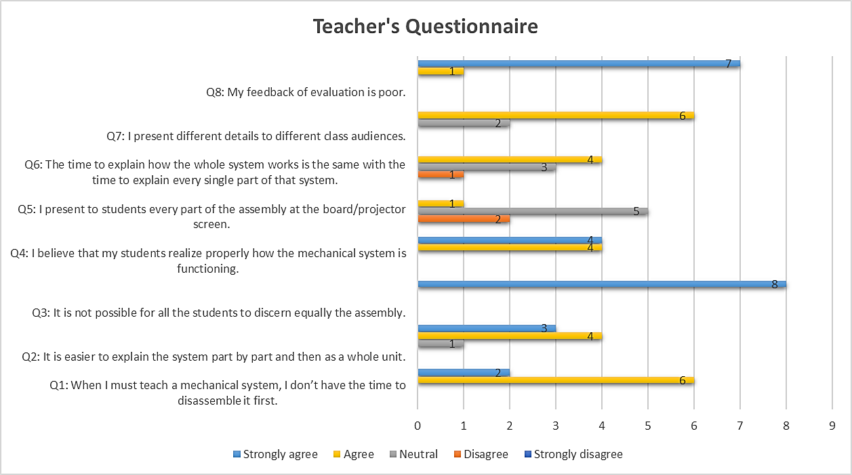

Slide 7
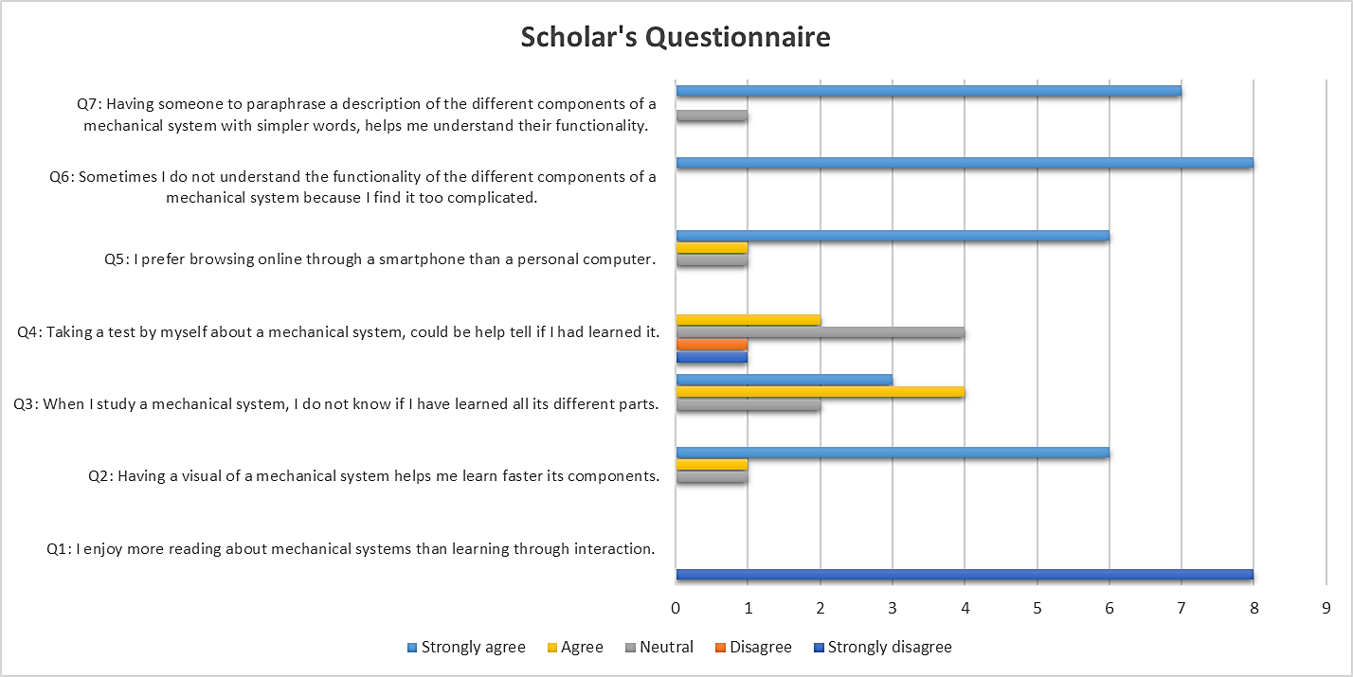

Slide 8
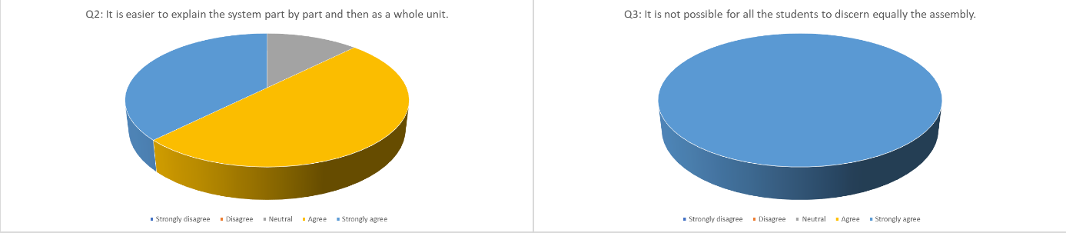
Project details [Part #1]
The methodology used to discuss and collect data from potential users.
The results of our survey showed clearly that there are objective problems which make it difficult for the instructor to demonstrate the functioning of a mechanical system so as for the student to realize it.
The complexity of a system, demands to consequently visualize the overall assembly and simultaneously define every part.

Slide 9
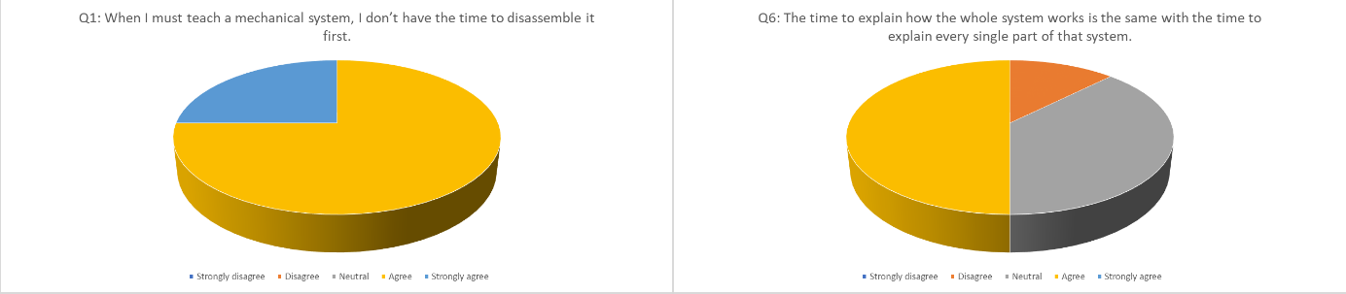
Project details [Part #1]
The methodology used to discuss and collect data from potential users.
The limited time teaching schedule is critical for the overall understanding.
Notes:
Different class levels and particularities in the learning profile of the students, proves that learning procedure over time is not a static element. Thus, educators may bypass easier parts or reach to a poor result of comprehension depending on time availability.

Slide 10
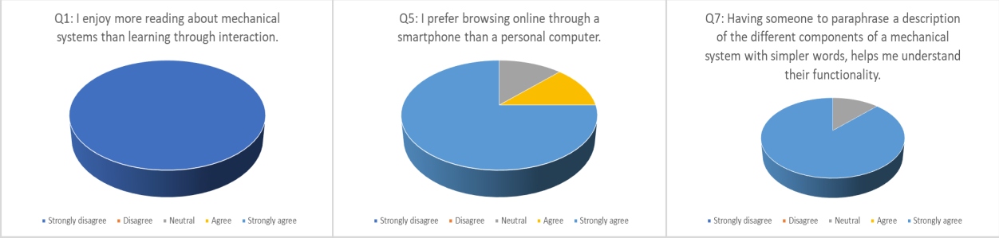
Project details [Part #1]
The methodology used to discuss and collect data from potential users.
Another concern is the obvious luck of student’s prerequisite knowledge that demands an extra level of simplification and formative assessment to be sure that they understood.
As for the student’s simplicity shake, the profound direct processed information by accessing their mobile device or pc, is their way.

Slide 11
Project details [Part #1]
The system’s design
The system shall be a web application for automotive engineering students to learn the different components of mechanical systems through an interactive way.
The students shall be able to test their knowledge on each different system.
Different levels of difficulty should be available since the web application will assist high school students and undergraduates as well.

Slide 12
Project details [Part #1]
The system’s design
• Hardware:
The web application will be hosted in a hosting service online (e.g., Hostinger, Amazon AWS)
For testing the web application, a private localhost server shall be used.
3D VR glasses (desktop) or a camera for AR (mobile) shall be used in the final product to see in the real world the scale of the different components of a mechanical system.
• Software:
Angular.js
Three.js (library for 3D rendering) - Not to be utilized at the current stage since 2D images will be used.
JavaScript
Bootstrap
HTML, CSS
Express.js
Node.js
MongoDb-MongoDb Compass
• Input/Output devices:
Desktop: mouse (left-click, hover, scroll)
Mobile: touch
• Technical Restrictions:
Mobile: In the mobile devices since hover is not available, after clicking on a component its description will become visible, while in the desktop after hovering above it.
WIMP (Windows, Icons, Menus, Pointers) easy to use interface for uploading models and their descriptions as an educator.

Slide 13
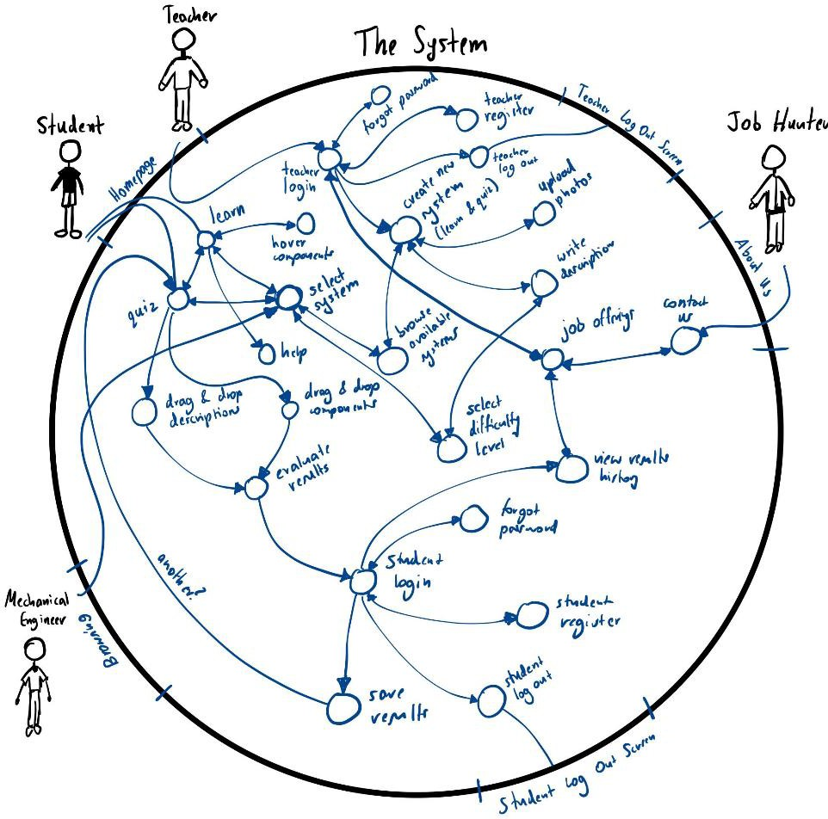

Slide 14
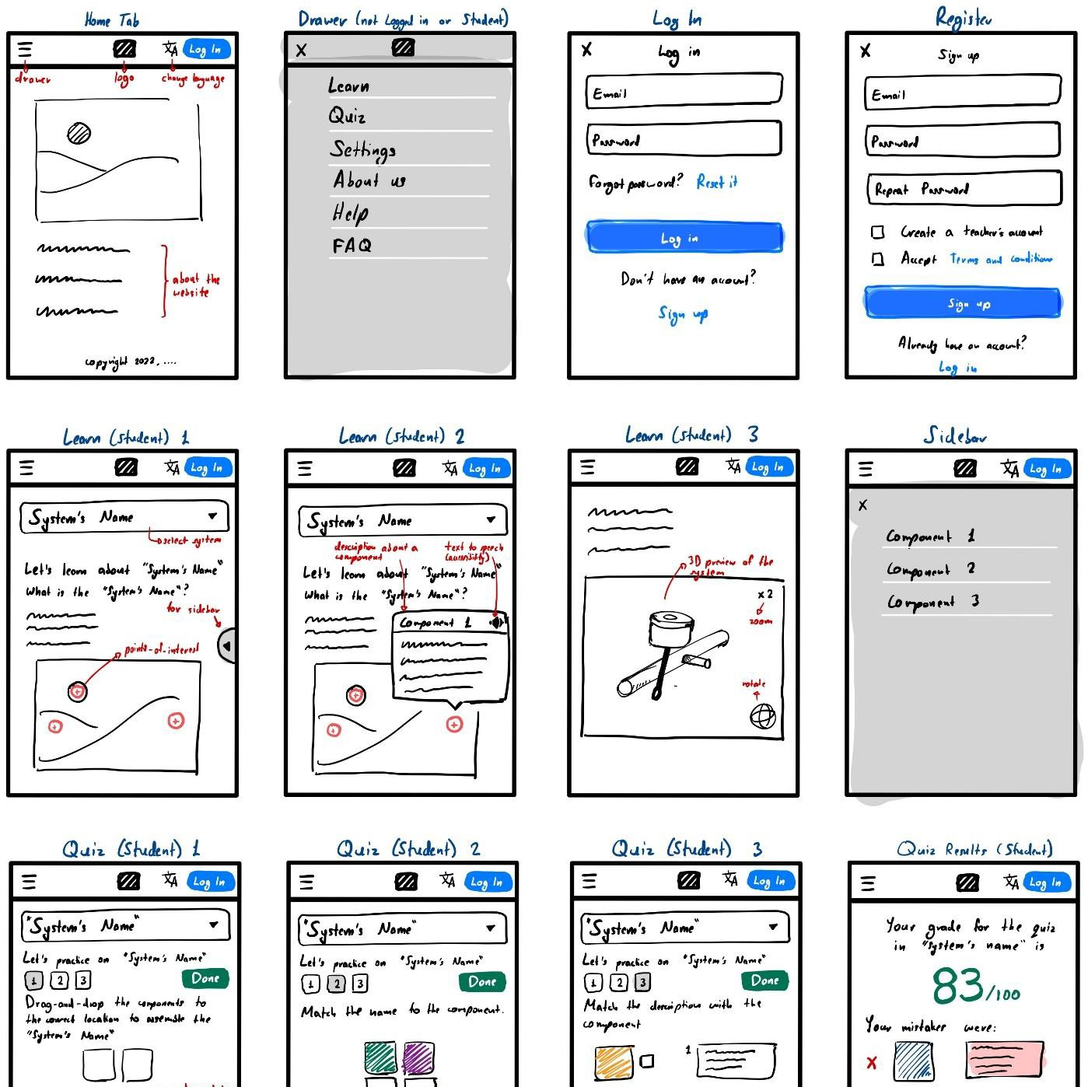

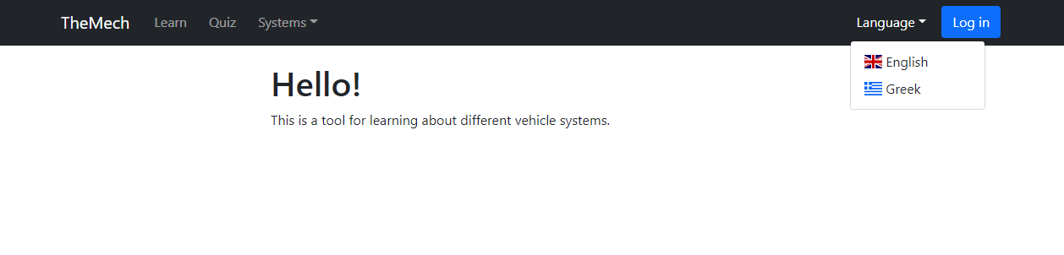
Project details [Part #1]
Prototype Design & Evaluation

Slide 15

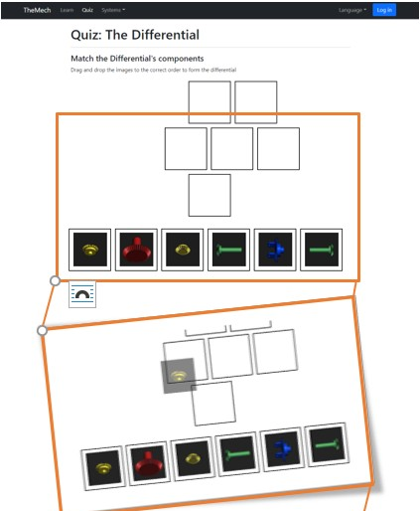

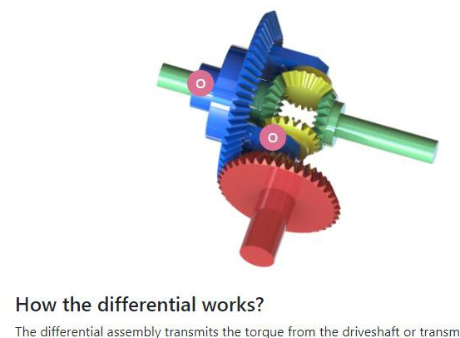
Project details [Part #1]
Prototype Design & Evaluation
We used Bootstrap, JavaScript, HTML, CSS and jQuery to create a medium fidelity prototype of the Website View. Simple functionalities were implemented. Examples of such functionalities are the drop-down menus, the navigation between sides,
drag-and-drop of images (Quiz Tab) and area mapping on
images (Learn Tab).

Slide 16
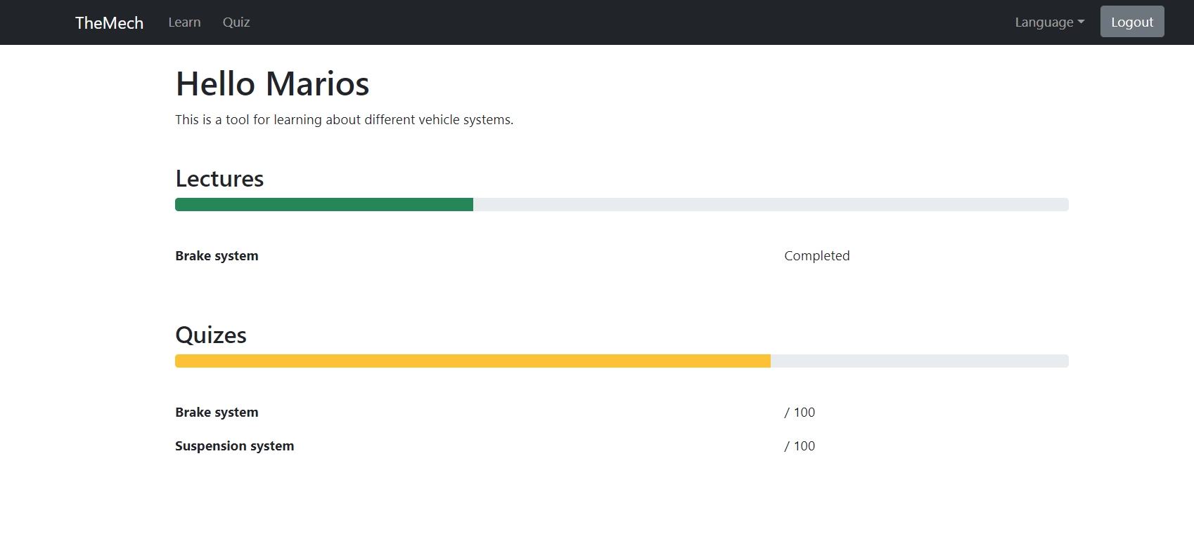

Slide 17
Project details [Part #2]
A clear analysis of the parts of the work done by each member of the group
Marios Pafitis
Implementation of the Navigation Bar, and the Learn, Quiz, and Systems Views using Html/css and boostrap.
Implementation of the DOM behaviour using Angular
Implementation of the database structure using Mongodb and json scrypts
Implement the authentication encryption using javascript and bcrypt module
Vasileios Samaras
Implementation of the the Learn, Quiz, and Systems content using Html/css and boostrap.
Implementation of the middlewares and routing using Express
Implementation of the Login and Register behaviour using Express and Mongodb

Slide 18
The requirements of the oral presentation are the following:
Describe in detail Project Part #1:
introduce the idea and compare it with existing solutions, [ok]
introduce the methodology used to discuss and collect data from potential users.
Decide the basics of your system design. Describe the User Requirements Specifications.
Introduce the Prototype Design.
Introduce the evaluation of your prototype designs.
2. Describe in detail Project Part #2: Describe the web system (main “screens”) and its functionality. Discuss your implementation as well as the technologies and methodologies used during the implementation. Discuss the evaluation and experiences.
3. Add a slide having a clear analysis of the parts of the work done by each member of the group (valid only in case of a group project)
4. Show and explain a promotional video (recommended, but optional)
5. Demonstrate your system.

